Slide 1
Bipartisan Safer Communities Act
Public Law 117-159 (June 25, 2022)
Division A, Title II - Firearms
Eric M. Epstein, Senior Policy Counsel (Firearms and Explosives)
James P. Vann, Acting Deputy Assistant Director (Public and Governmental Affairs)

Slide 2
The Bipartisan Safer Communities Act (effective June 25, 2022) contains the following amendments to the Gun Control Act of 1968 (GCA) and related provisions:
A new criminal “straw purchasing” offense, 18 U.S.C. § 932, that makes it illegal for someone to knowingly purchase, or conspire to purchase a firearm from either a licensee or a nonlicensee on behalf of a person they know or have reasonable cause to believe is prohibited from receiving a firearm, or who intends to use, possess, or transfer the firearm in furtherance of any federal or state felony.
A new criminal “firearms trafficking” offense, 18 U.S.C. § 933, that makes it illegal for a person to transfer or receive, or attempt or conspire to transfer or receive, a firearm if they know or have reasonable cause to believe the use, carrying, possession, or receipt would constitute any Federal or State felony.

Slide 3
New criminal offenses in 18 U.S.C. § 922(d) – section 922(d)(10) and (d)(11) – that prohibit the transfer of a firearm or ammunition to a person they know or have reasonable cause to believe intends to sell or otherwise dispose of the firearm or ammunition in furtherance of any federal or state felony or intends to sell or otherwise dispose of the firearm or ammunition to any prohibited person.
An amended 18 U.S.C. § 924(h), that makes it unlawful for a person to receive or transfer a firearm or ammunition, or attempt or conspire to do so, knowing or having reasonable cause to believe that it will be used to commit any federal or state felony.
An amended 18 U.S.C. § 924(k), that makes it unlawful for a person to smuggle a firearm or ammunition with intent to engage in or promote conduct that constitutes any federal or state felony, or to attempt or conspire to do so, not merely into the United States, but also out the United States if the conduct would constitute a felony prosecutable in a court of the United States if it had occurred within the United States.

Slide 4
Increased maximum terms of imprisonment in 18 U.S.C. § 924(a) for unlawful transfer and possession of firearms under the GCA, from 10 to 15 years, and up to 25 years if a straw purchased firearm is intended to be used to commit any federal or state felony.
An express directive to the United States Sentencing Commission that persons convicted under the straw purchasing and firearms trafficking offenses be subject to increased penalties in comparison to those under existing law, and particularly, that a person “affiliated with a gang, cartel, organized crime ring, or other such enterprise [are] subject to higher penalties than an otherwise unaffiliated individual.”

Slide 5
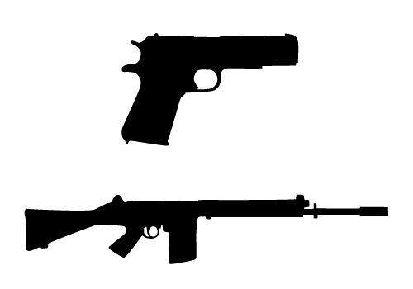
A broad, new criminal forfeiture provision, 18 U.S.C. § 934, authorizing the Government to seize and forfeit any proceeds or property derived by persons convicted under the new straw purchasing and firearms trafficking violations, as well as any property used, or intended to be used, in any manner to facilitate those new violations.

Slide 6
An amendment to 18 U.S.C. §§ 922(d) and (t) that extends the 922(d) prohibited recipient categories to juveniles, as applicable. With regard to the mental health provisions, which prohibit individuals from selling or providing firearms to persons whom they know or have reasonable cause to believe have been adjudicated as suffering from a mental defect or have been committed to any mental institution, the Act restricts the relevant time period to 16 years of age or older.
For firearms purchasers under the age of 21, maintains current law by requiring completion of a National Instant Criminal Background Check System (NICS) check within 3 business days, but requires NICS to immediately check state records for the purpose of determining whether the individual has a juvenile record that would disqualify them from purchasing firearms under section 922(d).
If NICS has notified the firearms dealer within 3 business days since the licensee contacted the system that cause exists to further investigate a possibly disqualifying juvenile record, there may be an additional delay of up to 7 more business days for records to be checked before the transfer may occur.

Slide 7
A provision narrowing the “boyfriend loophole” in 18 U.S.C. §§ 922(d)(9) and (g)(9) by adding those who are, or who recently were in, a dating relationship and have been convicted of a misdemeanor crime of domestic violence, after the passage of the bill, from purchasing or possessing a firearm for at least five years.

Slide 8
Allows Federal funds for State crisis intervention court proceedings and related programs or initiatives to be used for mental health courts, drug courts, veterans courts, and extreme risk protection order programs [i.e., red flag], which must include, at a minimum, pre-deprivation and post-deprivation due process rights that prevent any violation or infringement of the Constitution of the United States.
Authorization for Federal firearms licensees to use NICS to voluntarily conduct employment background checks on current or prospective employees without a fee, and for licensed manufacturers, importers, and dealers to verify whether firearms offered for sale to them have been stolen.

Slide 9
Questions?

