Slide 1
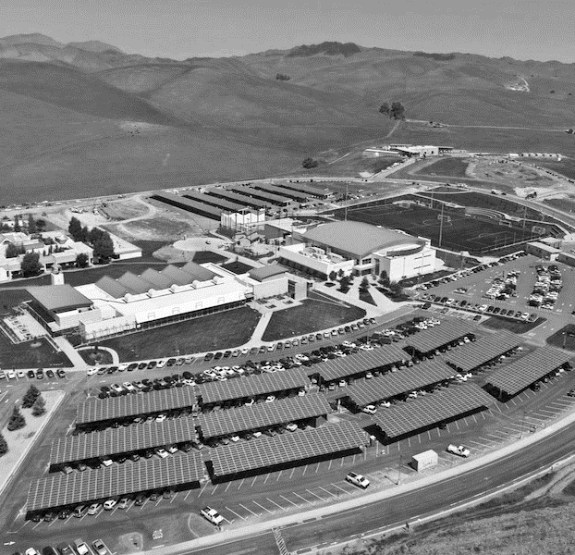
Microgrids
Overview
Josh Radoff (WSP)
Geoff Gunn (Arup)

Slide 2
Why Microgrids Now?
Microgrids are a proxy for building and district scale projects that tackle resilience and carbon.
Generally part of infrastructure and building projects to support sustainability and resiliency goals.
New technologies have emerged and costs have come down: solar, batteries, controls
Emergence of innovative business models / P3 opportunities
→ Microgrids are a means to an end!
→ Everything we talk about has a strong business case.

Slide 3
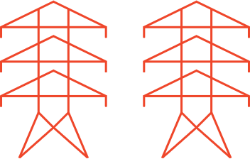



Basic Building or Campus Electrical Configuration
Benefits:
Works!
Generally low cost
Utility Grid
Building Load
Backup Generator

Slide 4
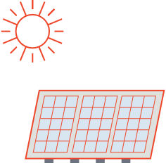
Add Solar
(or other onsite generation)
Benefits:
Reduced energy / cost
Third Party Finance
Reduced GHG
Utility Grid
Backup Generator
Solar Array
Building Load
Common Elements
Net Meter with 2-way flow
Backup generation can be supplemented by solar

Slide 5

Add Island-ability = Microgrid
Utility Grid
Benefits:
Resiliency
Self Production
Decarbonization
Microgrid
Solar Array
Building Load
Generator (cogen, etc.)
Common Elements
Critical load management (load controller)
Overall load and multiple generator control

Slide 6


Add Storage and More Controllable Loads
Utility Grid
Benefits:
Batteries enable 24/7 use of solar, demand shaving, arbitrage
EVs represent easily curtailable load and eventually V2G
Enables Cost externalization
Storage
Microgrid
Electric Vehicles
Solar Array
Building Load
Generator
Common Elements
Storage can buffer peaks and support backup
EVs can be selectively charged based on grid conditions or solar availability

Slide 7
Over time: replace backup generator with more batteries
Utility Grid
Benefits:
All electric
Zero carbon
Storage
Microgrid
Electric Vehicles
Solar Array
Building Load

Slide 8
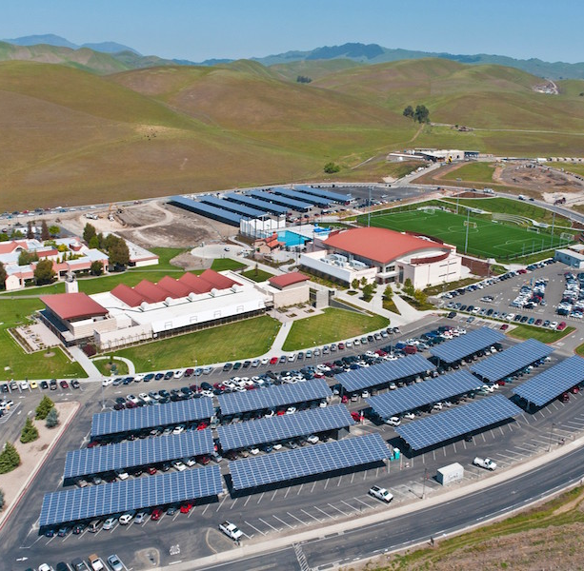
Las Positas College
Livermore, CA
Architect:
Client:
Project:
Services:
Features:
District scale energy and microgrid system serving the entire campus
Includes solar array, microgrid, the district thermal energy, thermal and battery storage systems

Slide 9
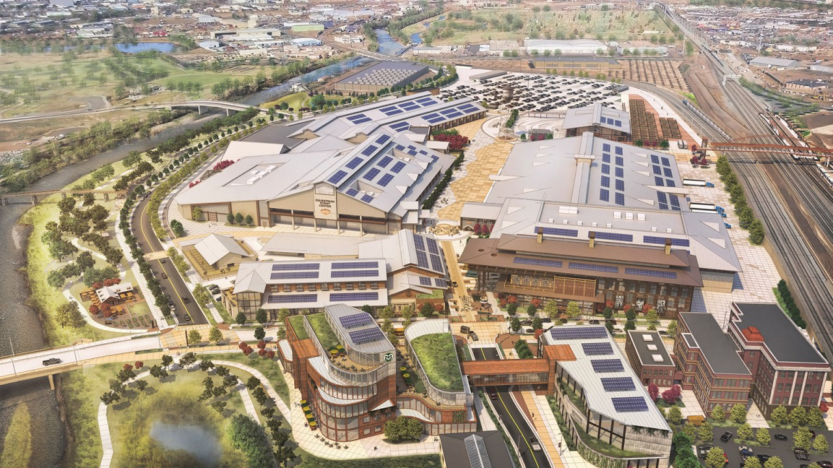
National Western Center
Denver, CO
Las Positas College
Livermore, CA
Architect:
Client:
Project:
Services:
Features:
District scale energy and microgrid system serving the entire campus
Includes solar array, microgrid, the district thermal energy, thermal and battery storage systems

Slide 10
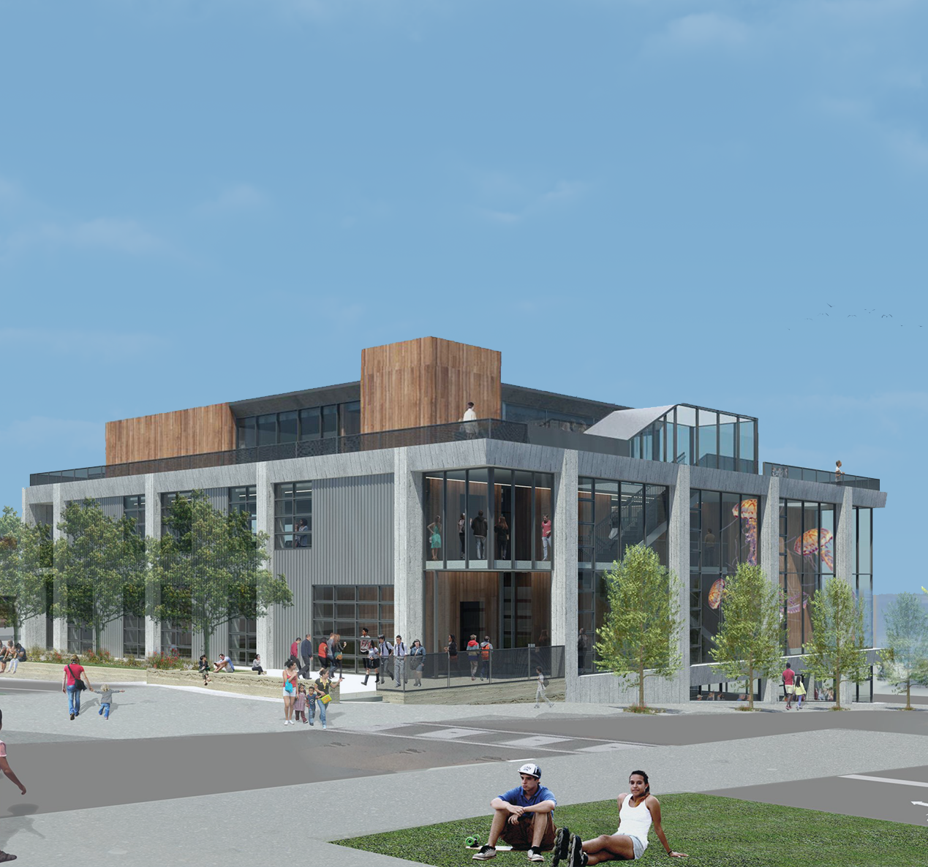
Monterey Bay Aquarium
Center for Ocean Education and
Leadership
Architect:
Client:
Project:
Services:
Features:
Microgrid supplies power in the event of a grid outage
30kW rooftop solar PV system
200kWh battery system

Slide 11
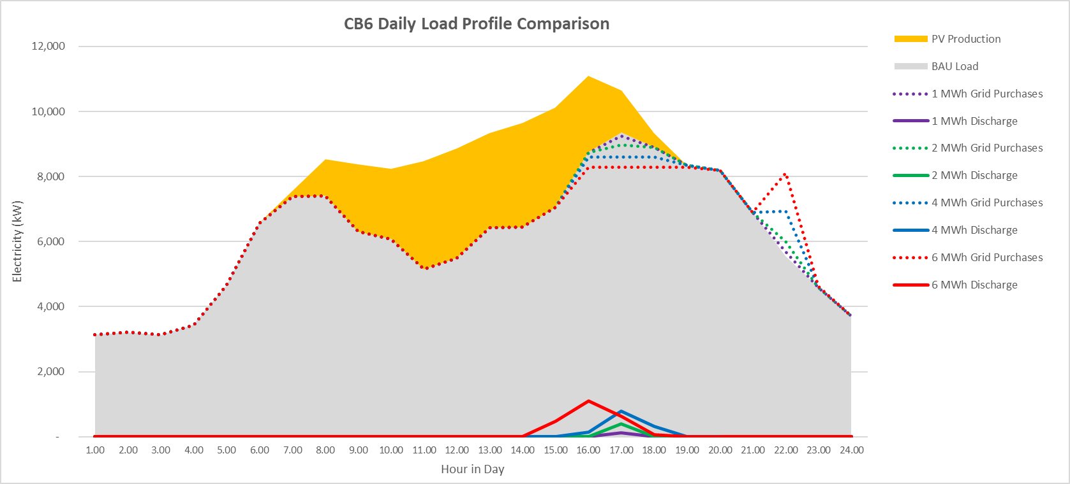
Battery Dispatch to Reduce Peak Demand
Resultant Load Before Batteries
Load Before Solar
4 MW Solar
Resultant Load After Batteries
Battery Discharging to Lower Peaks

Slide 12
California Market Adjustment
2017 – 2018 average hourly Market Adjustment for each month:
Hour in Day | Jan. | Feb. | Mar. | Apr. | May | June | July | Aug. | Sept. | Oct. | Nov. | Dec.
1 | -$0.01 | -$0.01 | -$0.02 | -$0.02 | -$0.02 | -$0.01 | -$0.01 | $0.00 | -$0.01 | $0.00 | $0.00 | $0.00
2 | -$0.01 | -$0.02 | -$0.02 | -$0.02 | -$0.02 | -$0.02 | -$0.01 | -$0.01 | -$0.01 | -$0.01 | $0.00 | $0.00
3 | -$0.01 | -$0.02 | -$0.02 | -$0.02 | -$0.02 | -$0.02 | -$0.01 | -$0.01 | -$0.01 | -$0.01 | $0.00 | $0.00
4 | -$0.01 | -$0.02 | -$0.02 | -$0.02 | -$0.03 | -$0.02 | -$0.01 | -$0.01 | -$0.01 | -$0.01 | $0.00 | $0.00
5 | -$0.01 | -$0.01 | -$0.02 | -$0.02 | -$0.02 | -$0.02 | -$0.01 | -$0.01 | -$0.01 | -$0.01 | $0.00 | $0.00
6 | -$0.01 | -$0.01 | -$0.01 | -$0.01 | -$0.01 | -$0.01 | -$0.01 | $0.00 | -$0.01 | $0.00 | $0.00 | $0.00
7 | $0.00 | $0.01 | $0.00 | $0.00 | -$0.01 | -$0.02 | -$0.01 | $0.00 | $0.00 | $0.01 | $0.01 | $0.01
8 | $0.00 | $0.00 | $0.00 | -$0.01 | -$0.02 | -$0.02 | -$0.01 | $0.00 | -$0.01 | $0.01 | $0.02 | $0.02
9 | -$0.01 | -$0.01 | -$0.02 | -$0.02 | -$0.03 | -$0.02 | -$0.01 | -$0.01 | $0.00 | $0.00 | $0.01 | $0.01
10 | -$0.01 | -$0.02 | -$0.02 | -$0.02 | -$0.03 | -$0.02 | -$0.01 | -$0.01 | -$0.02 | -$0.01 | $0.00 | $0.00
11 | -$0.01 | -$0.02 | -$0.02 | -$0.03 | -$0.03 | -$0.02 | -$0.01 | -$0.01 | -$0.01 | -$0.01 | -$0.01 | $0.00
12 | -$0.01 | -$0.02 | -$0.03 | -$0.03 | -$0.03 | -$0.02 | -$0.01 | -$0.01 | -$0.01 | -$0.01 | -$0.01 | $0.00
13 | -$0.01 | -$0.03 | -$0.03 | -$0.03 | -$0.02 | -$0.02 | $0.00 | $0.00 | -$0.01 | -$0.01 | -$0.01 | -$0.01
14 | -$0.02 | -$0.02 | -$0.03 | -$0.03 | -$0.02 | -$0.01 | $0.00 | $0.00 | -$0.01 | -$0.01 | $0.00 | -$0.01
15 | -$0.01 | -$0.02 | -$0.03 | -$0.03 | -$0.02 | -$0.01 | $0.00 | $0.01 | $0.00 | -$0.01 | $0.00 | -$0.01
16 | -$0.01 | -$0.02 | -$0.03 | -$0.02 | -$0.02 | -$0.01 | $0.02 | $0.02 | $0.00 | $0.00 | $0.00 | $0.01
17 | $0.00 | -$0.01 | -$0.02 | -$0.02 | -$0.02 | $0.00 | $0.03 | $0.02 | $0.01 | $0.00 | $0.02 | $0.03
18 | $0.02 | $0.02 | -$0.01 | -$0.02 | -$0.01 | $0.00 | $0.04 | $0.04 | $0.02 | $0.05 | $0.05 | $0.02
19 | $0.01 | $0.01 | $0.00 | -$0.01 | $0.01 | $0.03 | $0.08 | $0.07 | $0.06 | $0.08 | $0.03 | $0.03
20 | $0.01 | $0.00 | $0.01 | $0.01 | $0.02 | $0.04 | $0.08 | $0.07 | $0.03 | $0.03 | $0.02 | $0.03
21 | $0.00 | $0.00 | $0.00 | $0.01 | $0.02 | $0.01 | $0.05 | $0.03 | $0.01 | $0.01 | $0.02 | $0.02
22 | $0.00 | $0.00 | $0.00 | $0.00 | $0.00 | $0.01 | $0.02 | $0.01 | $0.00 | $0.01 | $0.01 | $0.02
23 | -$0.01 | -$0.01 | -$0.01 | -$0.01 | -$0.01 | -$0.01 | $0.00 | $0.00 | $0.00 | $0.01 | $0.01 | $0.01
24 | -$0.01 | -$0.01 | -$0.02 | -$0.02 | -$0.02 | -$0.01 | $0.00 | $0.00 | -$0.01 | $0.00 | $0.00 | $0.01
largest credit:
spring around noon
largest charge:
summer and fall evenings

Slide 13
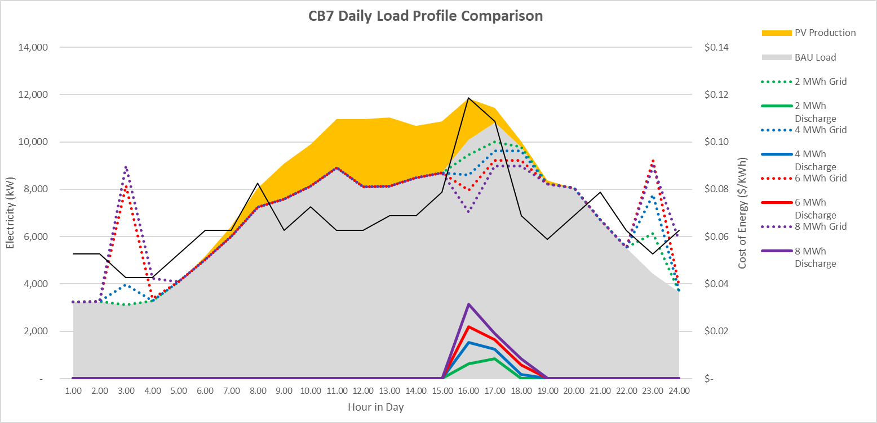
Battery Dispatch to Optimize Market Rate Fluctuations
Day Ahead Market Price
Resultant Load After Batteries
Battery discharging to manage MPBA and demand charge

Slide 14
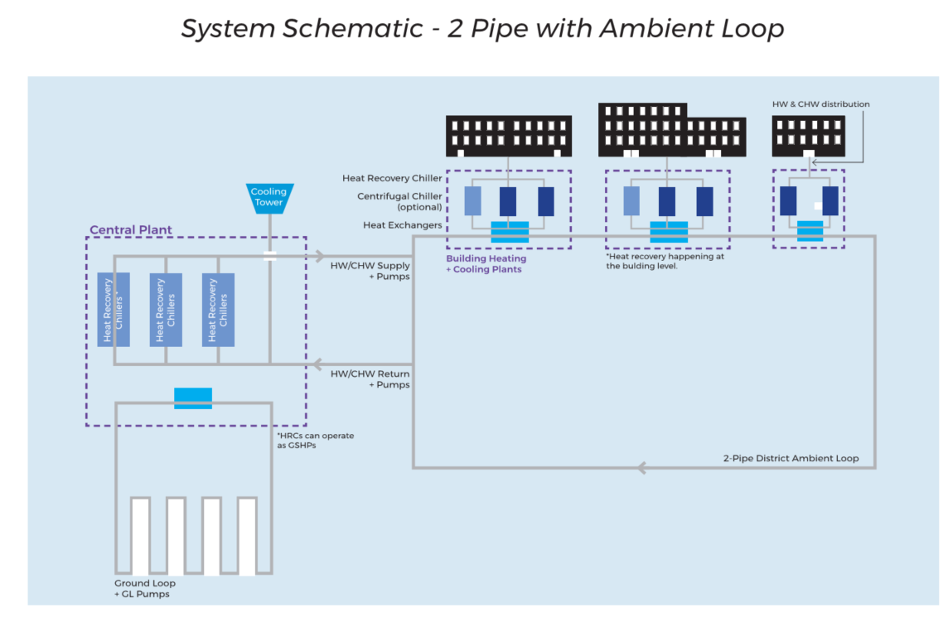
District Energy (Thermal)
Benefits:
Enables cost externalization
Supports efficiency and electrification

Slide 15
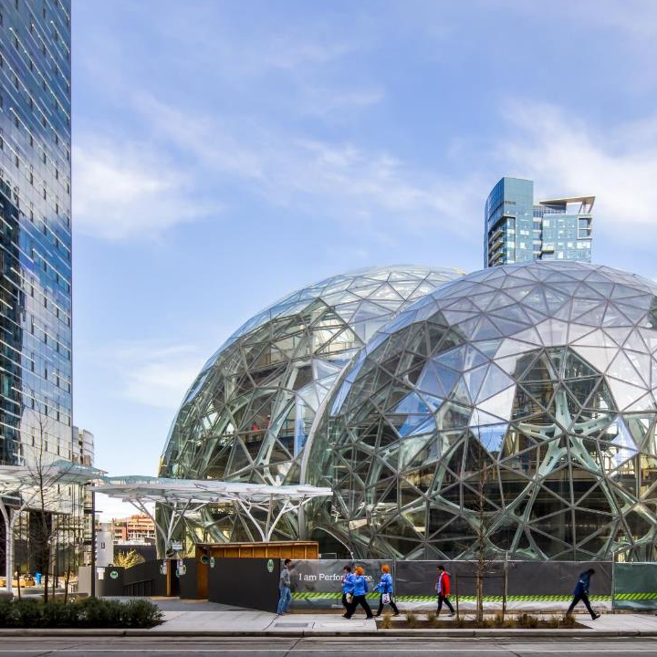
Amazon Campus
Seattle, WA
Size: ~5 million square feet over 5 towers, meeting buildings, and spheres
Features:
District energy systems in urban environment
Heat recovery/reuse from nearby data center
Notes:
General:
- Currently working on the 5th highrise building on the campus + "centers of energy" (low rise meeting buildings) + the spheres
- 1.1 MM each highrise building; Total ~5MM SF
Role:
- Mechanical/Plumbing, lighting design, design assist role
- Built ecology, full service on everything. Energy model, daylight model, spheres (comfort and light modeling)
District Energy
- Old converted parking garage to a data center, Amazon purchased the land from them.
- Brokering the deal was challenge
○ We were the technical arm in figuring out how this is going to work
○ Deal is predicated on how much heat is used
○ Tracking (M&V) to make sure amazon meets it’s obligations in terms of heat consumption
○ Amazon property development firm who led the charge, evangelist
○ We were the Amazon technical deal. They had their own engineer.
- Win - win for Amazon and data center owner
○ Data center saved on cooling tower use and water use
○ Allowed data center to expand
- 3rd party was created, owns the pipe across the street
- Harvests waste heat for the entire campus, use of hydronic heat in buildings
○ Enables all buildings to meet code with the same system
- Each building has it's own central plant
- Supplement with hot water boilers

Slide 16
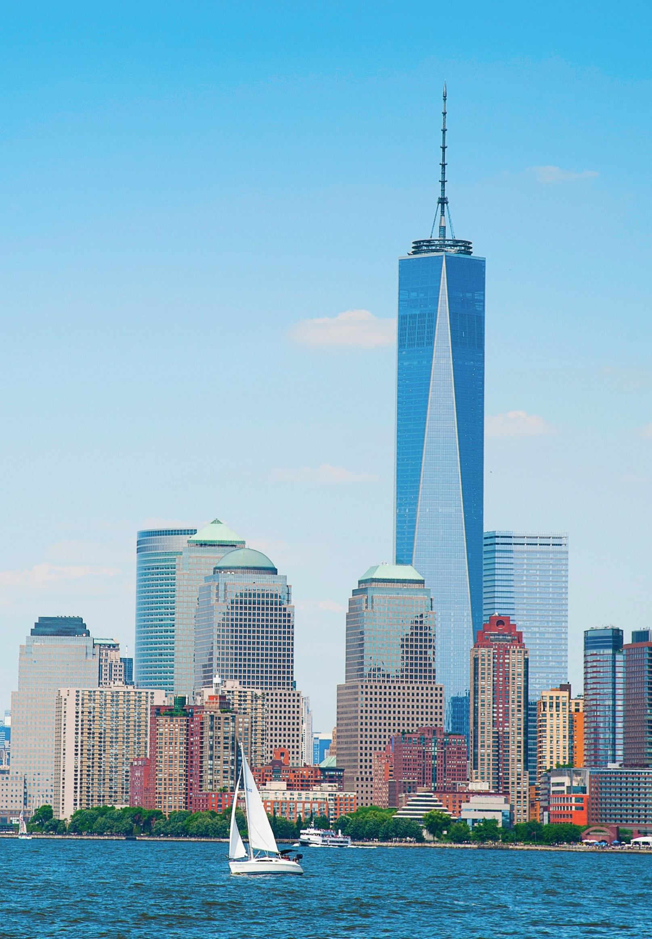
World Financial Center
New York, NY
Owner: Port Authority of NY & NJ
Features:
District scale chiller plant
Utilizes river water from the Hudson for cooling

Slide 17
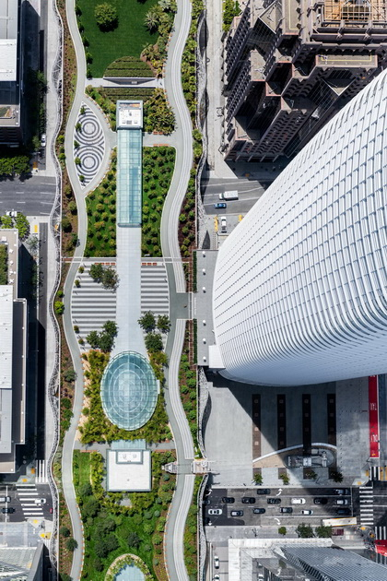
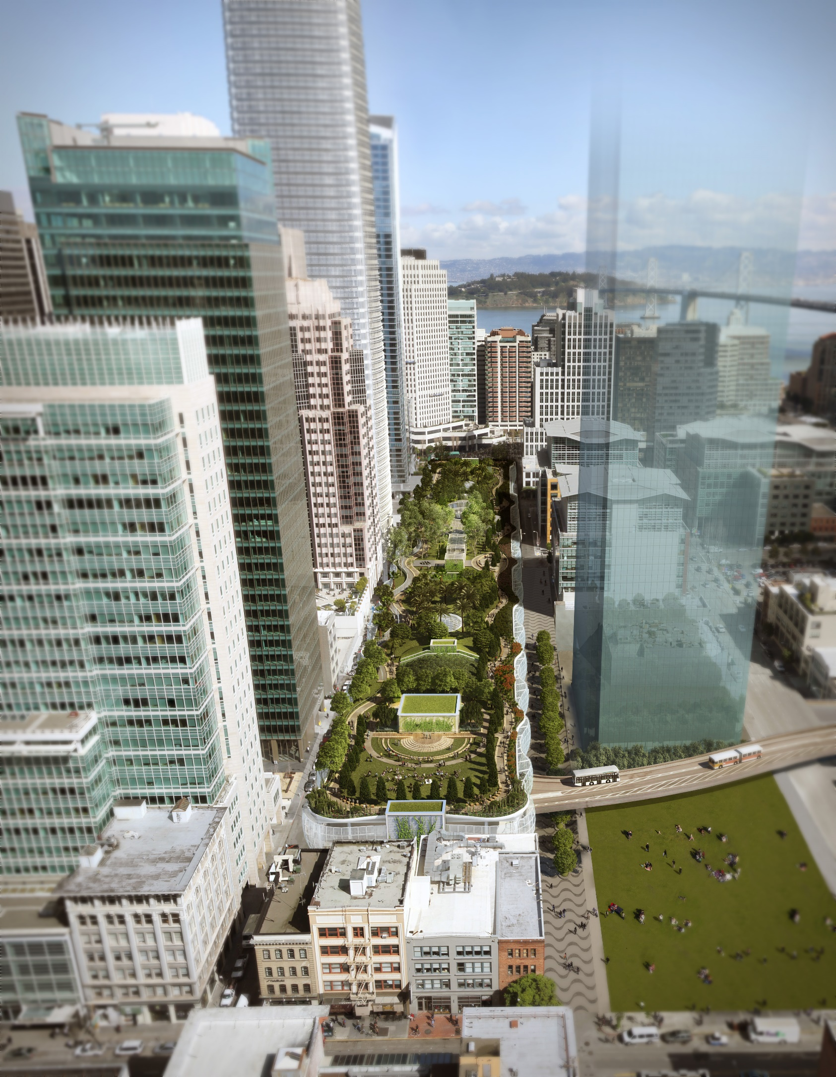
Transbay Transit Center
San Francisco, CA
Size: 1.5 million sf
Features:
Geothermal system (uses more than 10 miles of high-density polyethelyne piping)
Supported by underground tidal flows
Short-term storage in the rain and graywater recovery tanks
Notes:
Program Summary:
5.2M SF Office Space
1.06M SF Retail
2,000 Units Residential
700 Hotel Rooms
250,000 SF Food and Beverage
190,000 SF Entertainment

Slide 18
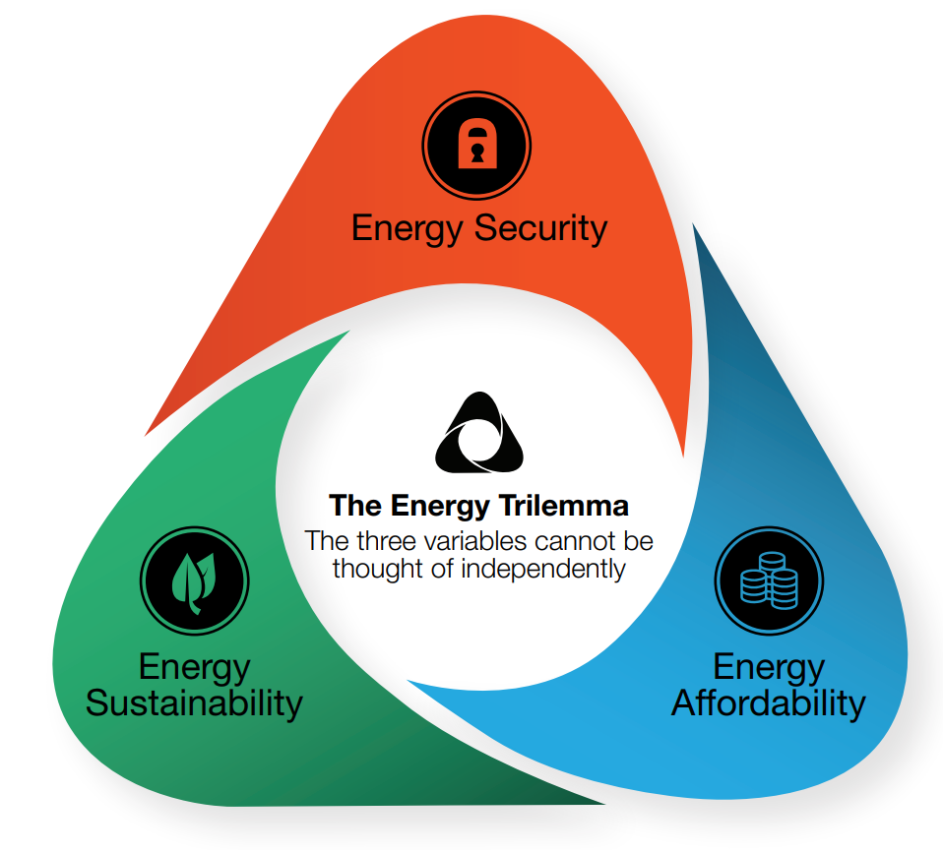

Microgrid Optimization
Need to balance:
Resilience
Sustainability and
Costs
Traditional metrics to evaluate solution effectiveness are insufficient
Notes:
Tweak bullet points to better speak to the various systems, and the challenges

Slide 19
Microgrid Financing
Direct Capital
Lease
PPA/EaaS
Notes:
Tweak bullet points to better speak to the various systems, and the challenges

Slide 20
Microgrid Financing
Direct Capital
Lease
PPA/EaaS
Energy Service Provider
Owner
Project Risk
Operational Control
Notes:
Tweak bullet points to better speak to the various systems, and the challenges

Slide 21
Microgrid Financing
Key factors to a bankable microgrid:
Availability of incentives
High electricity rates
Value of resilience of sustainability
Notes:
Tweak bullet points to better speak to the various systems, and the challenges

Slide 22
Microgrid Financing
Key factors to a bankable microgrid:
Availability of incentives
High electricity rates
Value of resilience of sustainability
Need to identify the underlying business case early
Notes:
Tweak bullet points to better speak to the various systems, and the challenges

Slide 23
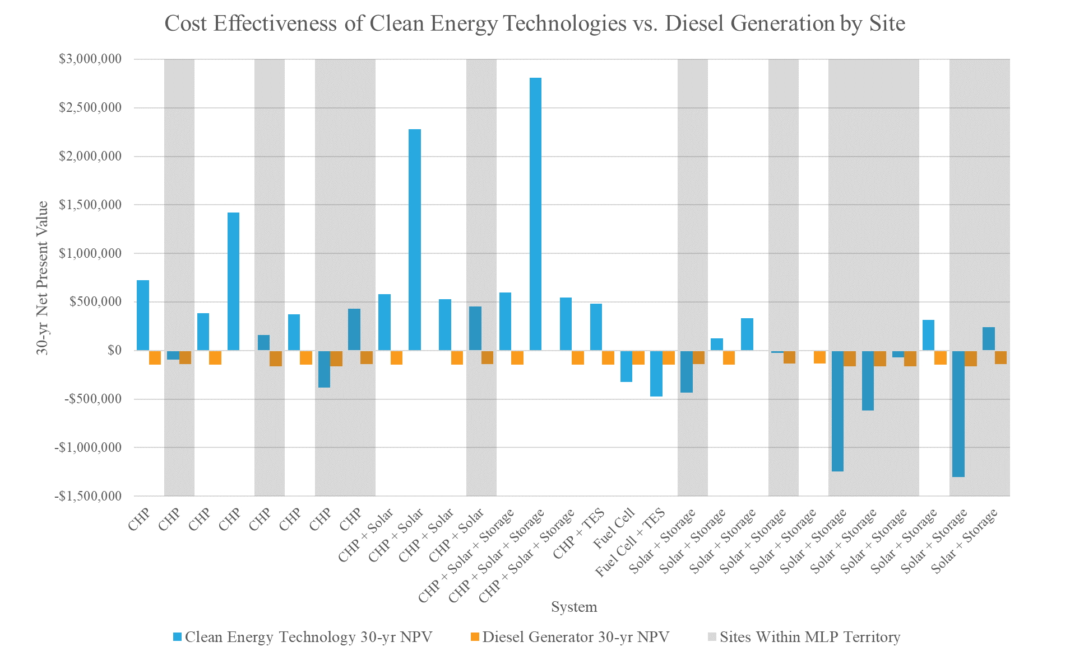
Notes:
Tweak bullet points to better speak to the various systems, and the challenges

Slide 24
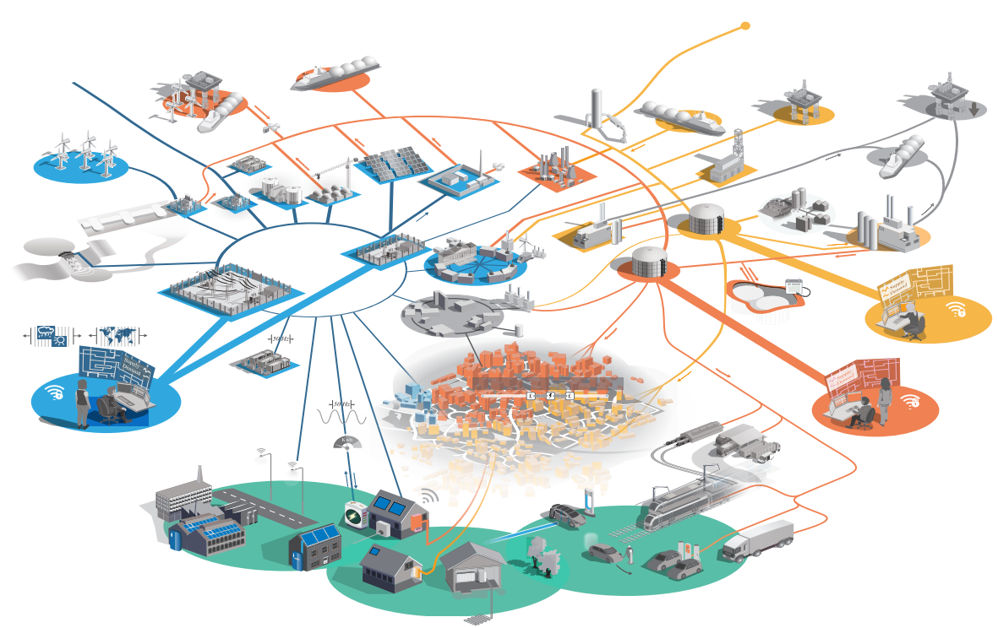
Microgrid Adoption
Need to identify:
Local drivers and goals
Available levers
    Permitting
    DPU
    Codes
    Zoning
    etc.
Build consensus and stakeholder engagement
Notes:
Tweak bullet points to better speak to the various systems, and the challenges

Slide 25
Thank you !

